Slide 1
COPADS
#10 – Distributed systems
IFEOLUWATAYO IGE

Slide 2
OUTLINE
Distributed system
Characteristics
Distributed Message Broker
Load Balancing Algorithms
Caching in Distributed Systems

Slide 3
What is a Distributed System?
A distributed system consists of multiple nodes (possibly across geographical boundaries) communicating and coordinating their actions through Message Passing (remote procedure call), and shared memory (reading or writing) via communication protocols.
Characteristics:
Resource sharing
Concurrency - multiple machines can do similar tasks at the same time
Scalability - computing and processing capabilities can be extended.
Fault tolerance - failure in one node (s) should not prevent overall performance of other nodes
Transparency- concealing the components of a distributed system from the user so that the system is perceived as a single one.
Location
Migration
Replication –users can not tell how many copies exist
Failures-Partial
Concurrency/parallelism

Slide 4
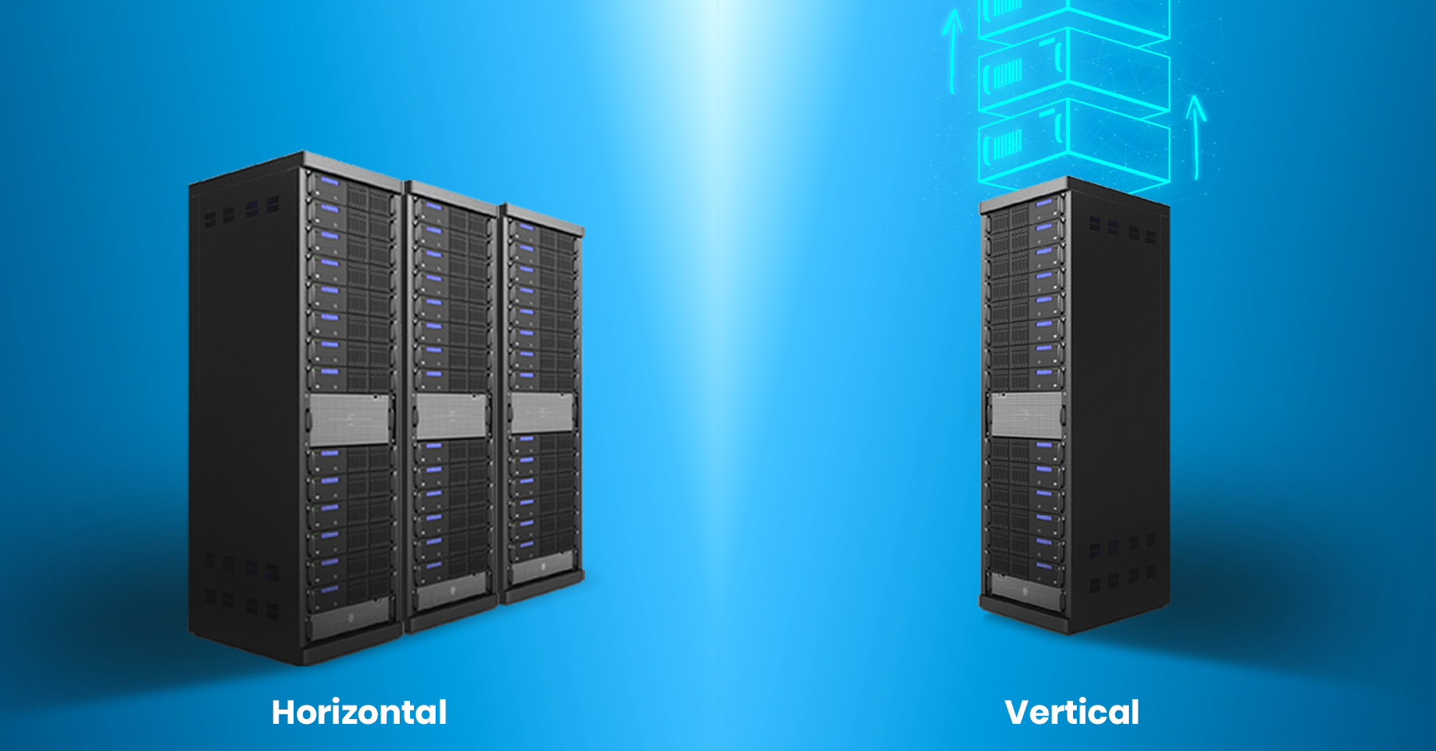
Why use a distributed system?
For better reliability: even if one node fails, the system as a whole can continue to function.
For better performance by distributing subtasks among nodes
To solve bigger problems: e.g. huge amounts of data that can’t fit on one machine
The hardware of a single machine could be upgraded to cater to increasing traffic. This is called Vertical scaling.
Scaling horizontally means adding more computers rather than upgrading the hardware of a single one.

Slide 5
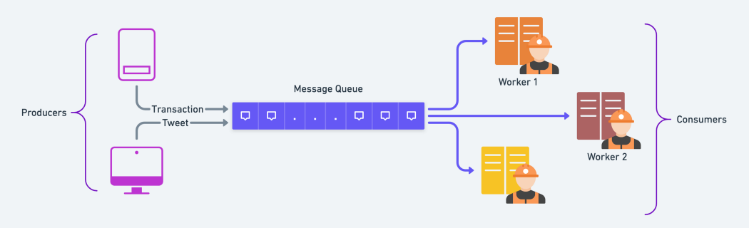
Distributed Message Broker
This is a piece of middleware responsible for routing and communicating messages in a distributed system
It relies on a Message Queue
This is a data type used by the message broker to store messages using FIFO logic until the consuming applications can process them.
Message broker software tools are available. Such as RabbitMQ, ZMQ, Apache ActiveMQ, Kafka, etc.

Slide 6
Message Broker Distribution Patterns
Point-to-point messaging
A one-to-one relationship between the message’s sender and receiver. Each message in the queue is sent to only one recipient and is consumed only once.
Examples include payroll and financial transaction processing since payment needs to be done only once
Publish/subscribe messaging:
One-to-many relationship between the message sender and receiver(s).
Ex. An airline system should continuously share updates about its landing time and location. These updates should be shared among several parties such as ground crews (to prepare for landing), the control center (to manage flights), the public etc.

Slide 7
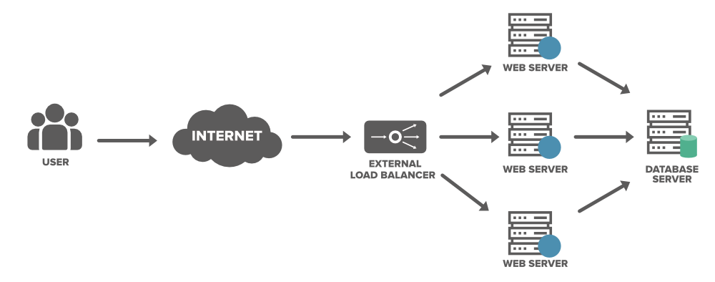
Load Balancing in Distributed Systems
Load balancing can be defined as an efficient distribution of requests across multiple servers/nodes.

Slide 8
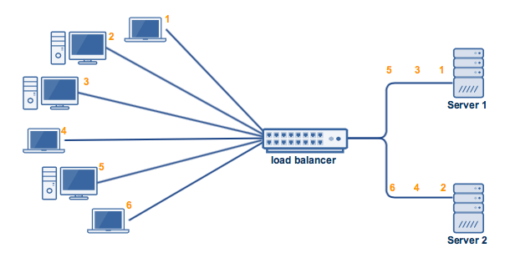
Load Balancing Algorithms
1. Round Robin (static):
Distributes traffic across servers equally
The Round Robin algorithm is best for clusters consisting of servers with identical specs
If Server 1 had more CPU, RAM, and other specs compared to Server 2. Server 1 should be able to handle a higher workload than Server 2, right?
Despite the two servers' disproportionate capacities, the load balancer will still distribute requests equally. As a result, Server 2 can get overloaded faster and probably even go down. You wouldn't want that to happen.

Slide 9
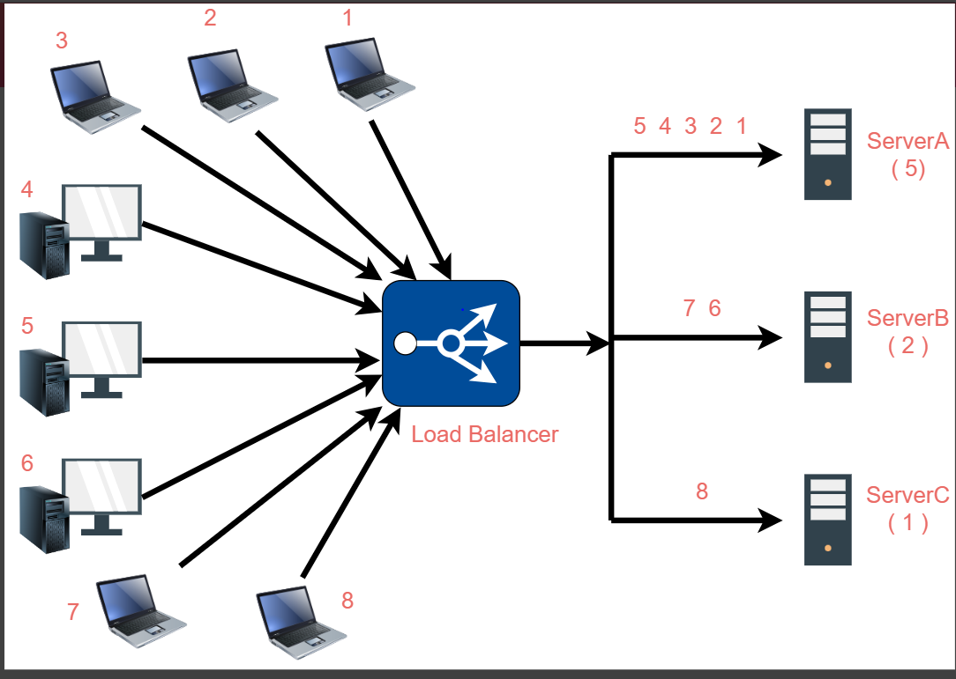
2. Weighted Round Robin (static):
The network administrator assigns a numeric weight to all the servers based on factors such as the server’s processing power or total bandwidth.
Then, assigns more requests to the server with a higher capability of handling a greater load based on the weights.
For Example: ServerA, ServerB, ServerC— with weights (5, 2, 1) are waiting to accept incoming requests
The load balancer will forward the first five requests to ServerA, the next two requests to ServerB, and then one request to ServerC.
If any of the other incoming requests arrive, the load balancer will forward those requests back to ServerA again for the next five incoming requests, then ServerB will get its turn, and after that the requests will be forwarded to ServerC.

Slide 10
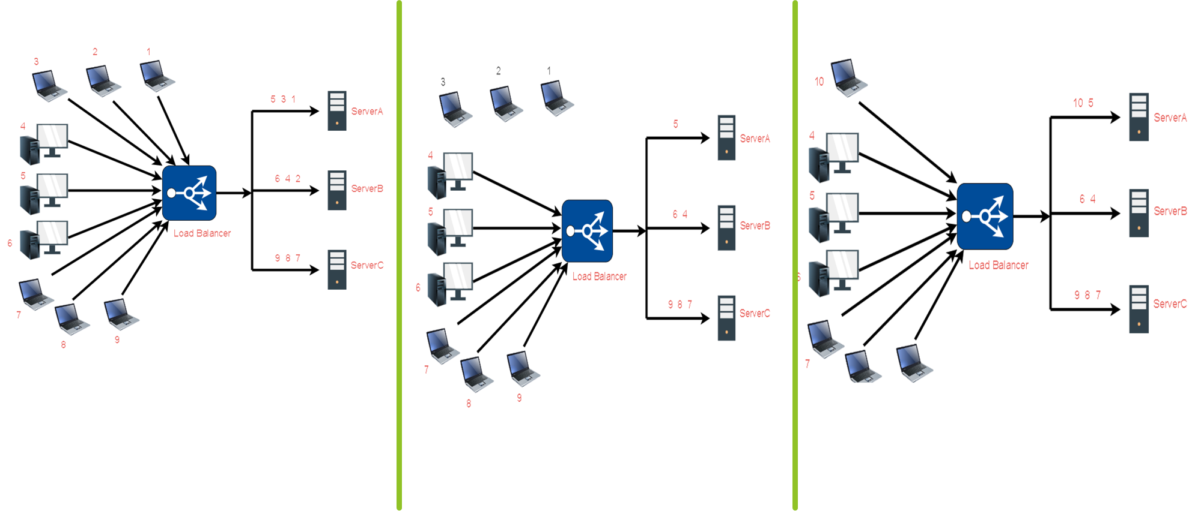
3. Least Connection (Dynamic):
This algorithm takes into consideration the number of current connections each server has. When a client attempts to connect, the load balancer will try to determine which server has the least number of connections and then assign the new connection to that server.

Slide 11
4. Weighted Least Connection (Dynamic):
This introduces a "weight" component based on the respective capacities of each server. Weights are specified beforehand.
Takes into consideration two things: the capacities of each server AND the current number of clients currently connected to each server before assigning clients.
5. Random (Static)
Randomly maps requests to servers
Good when servers have the same specs.

Slide 12
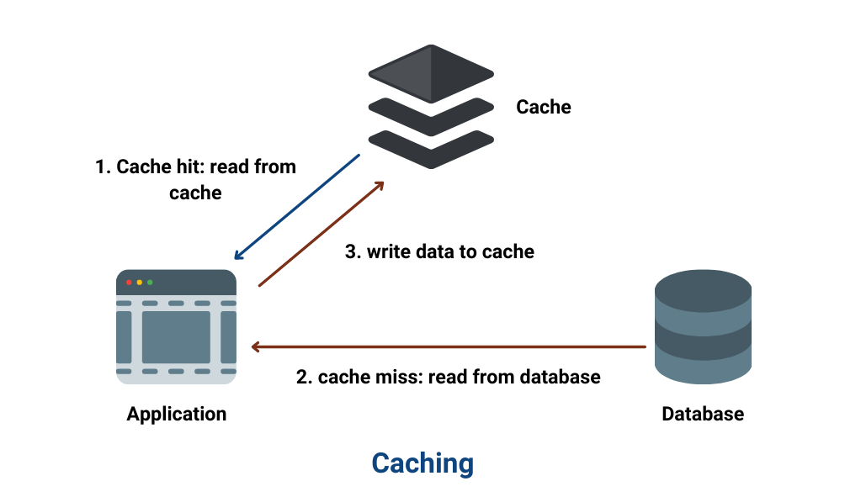
Distributed Caching
A distributed cache is a mechanism that stores frequently accessed data across several nodes in a cluster to reduce the load (reducing the number of requests) on the database and improve the speed of data access

Slide 13
Distributed Caching Strategies
PASSIVE CACHING
1. Read-Through:
The data is initially written directly into the database, and then from the database, it is loaded into the cache
When the user sends a request for certain data, the system first looks for it in the cache. If present, it’s returned. If not, the data is fetched from the database, the cache is updated, and is returned to the user.
This strategy works best with read-heavy workloads (data is not frequently updated).
Drawback:
The developers must write logic for cache management and synchronization with the database explicitly to ensure data consistency as there is a possibility of data inconsistency between the cache and the database.
This can be solved if the cache has a TTL (Time To Live). After TTL expires, the data is invalidated from the cache

Slide 14
Distributed Caching Strategies
2. Write-Through:
Every piece of information written to the database is simultaneously written to the cache.
This maintains strong consistency between the cache and the database
This works well for use cases where the reliability and durability of data are crucial. For instance, transactional systems, like stock trading, banking applications, etc.
Drawback:
It adds a little latency during the write operations as data is to be updated in the cache additionally
3. Write-Back:
The data is directly written initially to the cache
The cache writes data to the database after some delay as per the business logic.
This helps optimize costs significantly. If there are quite a heavy number of writes in the application, developers can reduce the frequency of database writes to cut down the load and compute costs
Invariably faster in terms of speed when compared to Write-Through.
Drawback:
High Volatility. There is a risk of data loss in this approach. If the cache fails before the DB is updated, the data might get lost.

Slide 15
Distributed Caching Strategies
ACTIVE CACHING:
This actively retrieves and stores data in the cache before the user requests it. The system predicts which data the user or system is likely to request next and proactively loads that data into the cache, thus reducing the wait time for the user.
It often involves algorithms or mechanisms to predict which data will be needed next.
This is more commonly used for prefetching cached data in web browsers or content delivery networks based on user behavior and navigation patterns which will significantly improve application performance.
Benefits:
Reduced Latency: This can significantly reduce the latency for serving requests as cached data is preloaded.
Optimized for Predictability: This can significantly benefit systems where user behavior and data access patterns are predictable,
Drawbacks:
Resource Intensive: Can be more resource-intensive due to the constant need to predict and load data
Complex Implementation: Implementation can be a bit more complex due to the need for accurate predictive algorithms and mechanisms to determine what data to cache

Slide 16
Distributed Caching Strategies
Active or Passive Caching?
Active caching is especially beneficial in environments where minimizing latency is crucial, despite its inherently higher resource consumption and implementation complexity. Could be used in real-time web applications and high-traffic services.
Passive caching is a go-to strategy when simplicity and resource efficiency are prioritized, particularly suitable for systems with unpredictable or spontaneous data requests.

Slide 17
Why are distributed systems hard to implement?
Watch: https://www.youtube.com/watch?v=w9GP7MNbaRc&t=1930s

